Slide 1
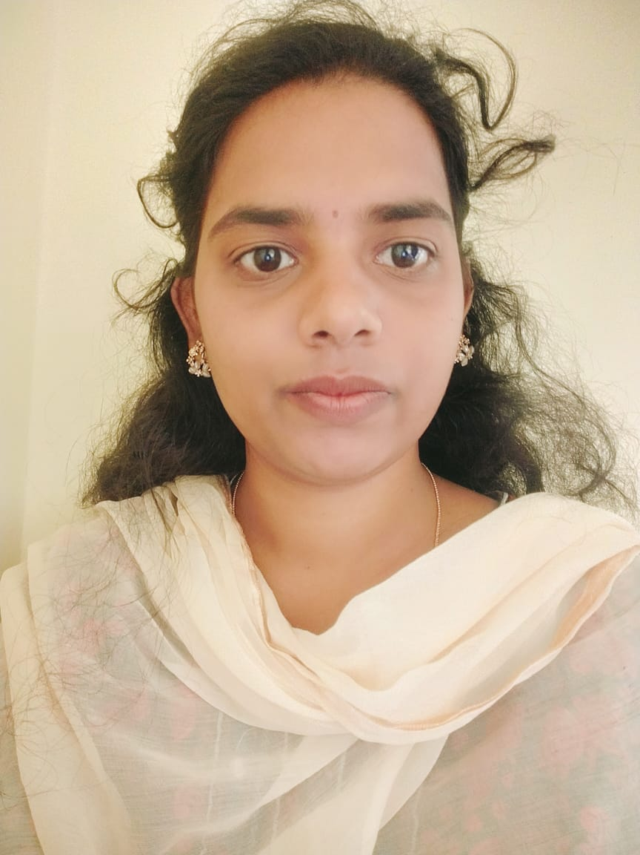
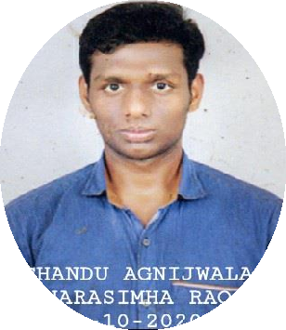
Pichili sreevallika
Analyst/Software Engineer
E-Mail: PICHILI.SREEVALLIKA@CAPGEMINI.COM
Education and certificates
Bachelor of Technology : 2017 – 2021 (Mechanical Engineering)
Call:
City: Nationality: Languages:
6302230429
Andhra Pradesh Indian
English, Telugu
Skills Java ReactJs Html & Css
Backend
Spring boot
Profile
Myself Pichili Sreevallika , done the training part in the domain of ‘Java full stack with React’. And deserved to be the right fit for the current requirements
Eager to work in a team of dedicated people and serve a key role in the enhancement and development of the project.
Had the assignment level experience in the technologies such as Java, Spring and React.
Scaling the skills every single day on the current new technologies. And holding good understanding on the current mandatory tools such as Version Control System(Git & GitHub).
Assignments
Multiplex Booking system
Completed end to end case study of Multiplex Booking system,postman testing using Spring boot ,React and MYSQL.
Frontend
React
Database
SQL database – MYSQL
Add-ons GitHub and Git Maven Postman
Additional Skills
Good Communication Skills

